Slide 1
Book1
File created on: 4/13/21 11:48:14 PM GMT+05:30

Slide 2
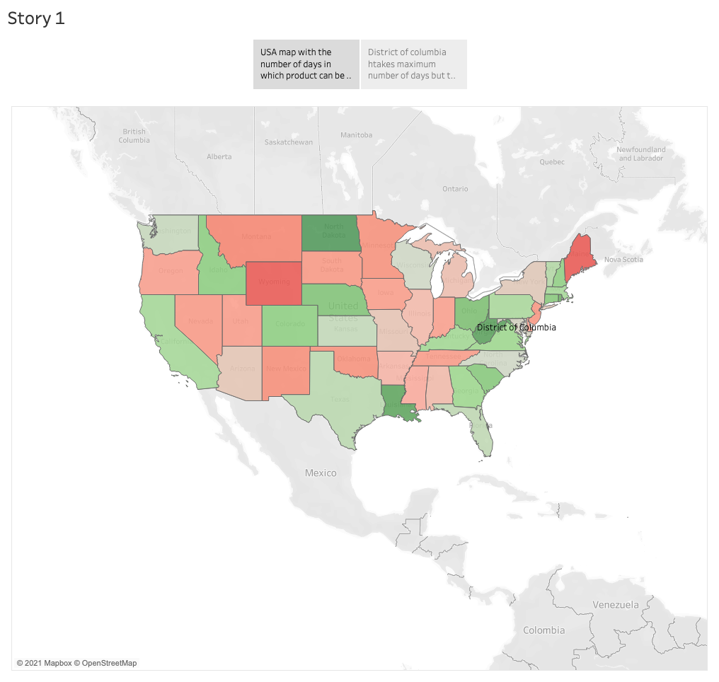

Slide 3
